Slide 1
License Plate Recognition
Computer Vision Project III
710882199 - Enzo Haegel
410985099 - Savelii Spitsin

Slide 2
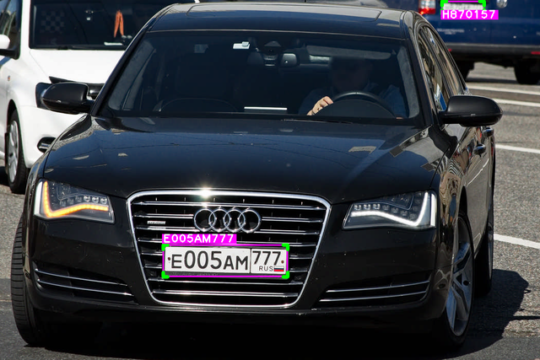
License Plate Recognition using OpenCV and EasyOCR
Pipeline:
Video Processing
License Plate Extraction
Text Recognition

Slide 3
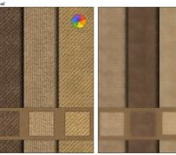
License Plate Recognition using OpenCV and EasyOCR
Load the video
Frame Preprocessing
- Resizing the frame using imutils.resize
- Converting to grayscale
- Applying Bilateral Filtering
- Canny edge detection
Contour Detection
-Find contours in the edge image using the cv2.findContours function.
- Sort the contours by area in descending order to prioritize larger contour

Slide 4
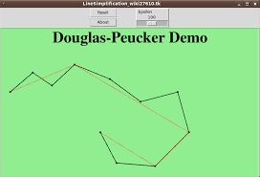
License Plate Extraction
Iterate over the contours and approximate their shape using the Ramer-Douglas-Peucker algorithm.
Check if the approximated contour has four corners, which indicates a rectangular shape.
Check if the approximated contour has four corners, which indicates a rectangular shape.
Select the first contour that meets the criteria, assuming it represents the license plate.
Extract licence plate cropped image for recognition

Slide 5
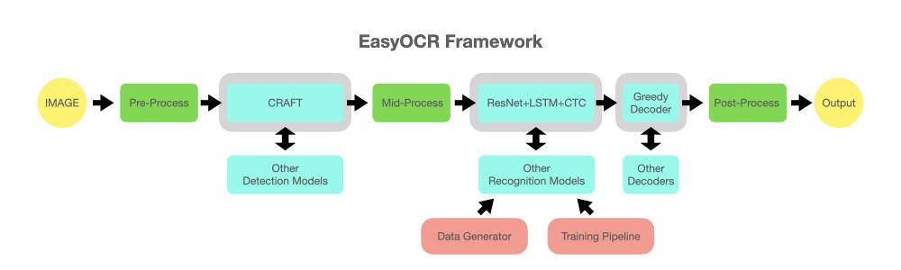
Text Recognition

Slide 6
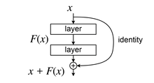
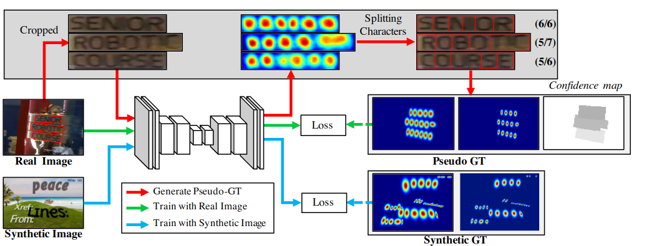
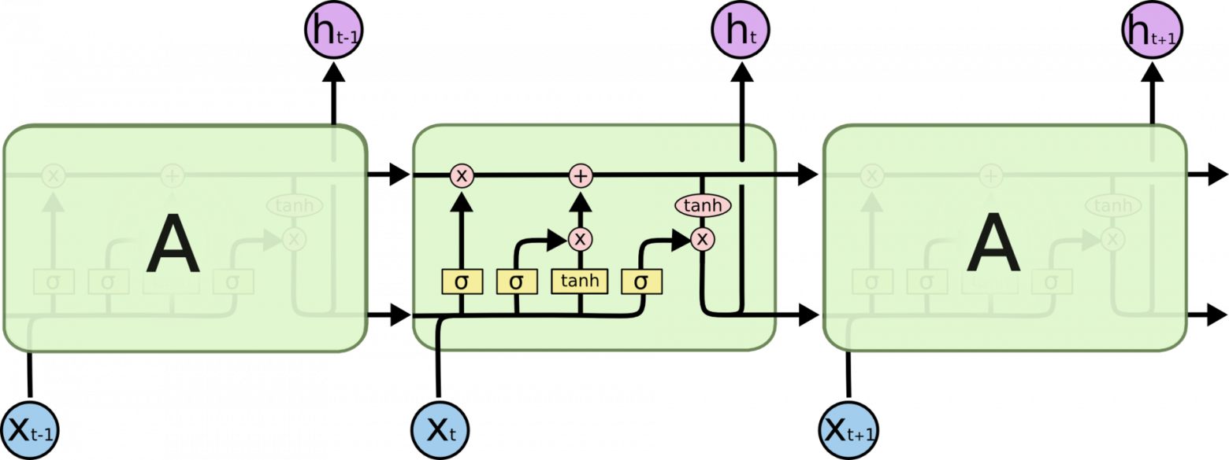
CRAFT - Character Region Awareness for Text Detection
ResNet - Residual Neural Network
LTSM - Long Short-Term Memory
CTC loss - Connectionist Temporal Classification loss

Slide 7
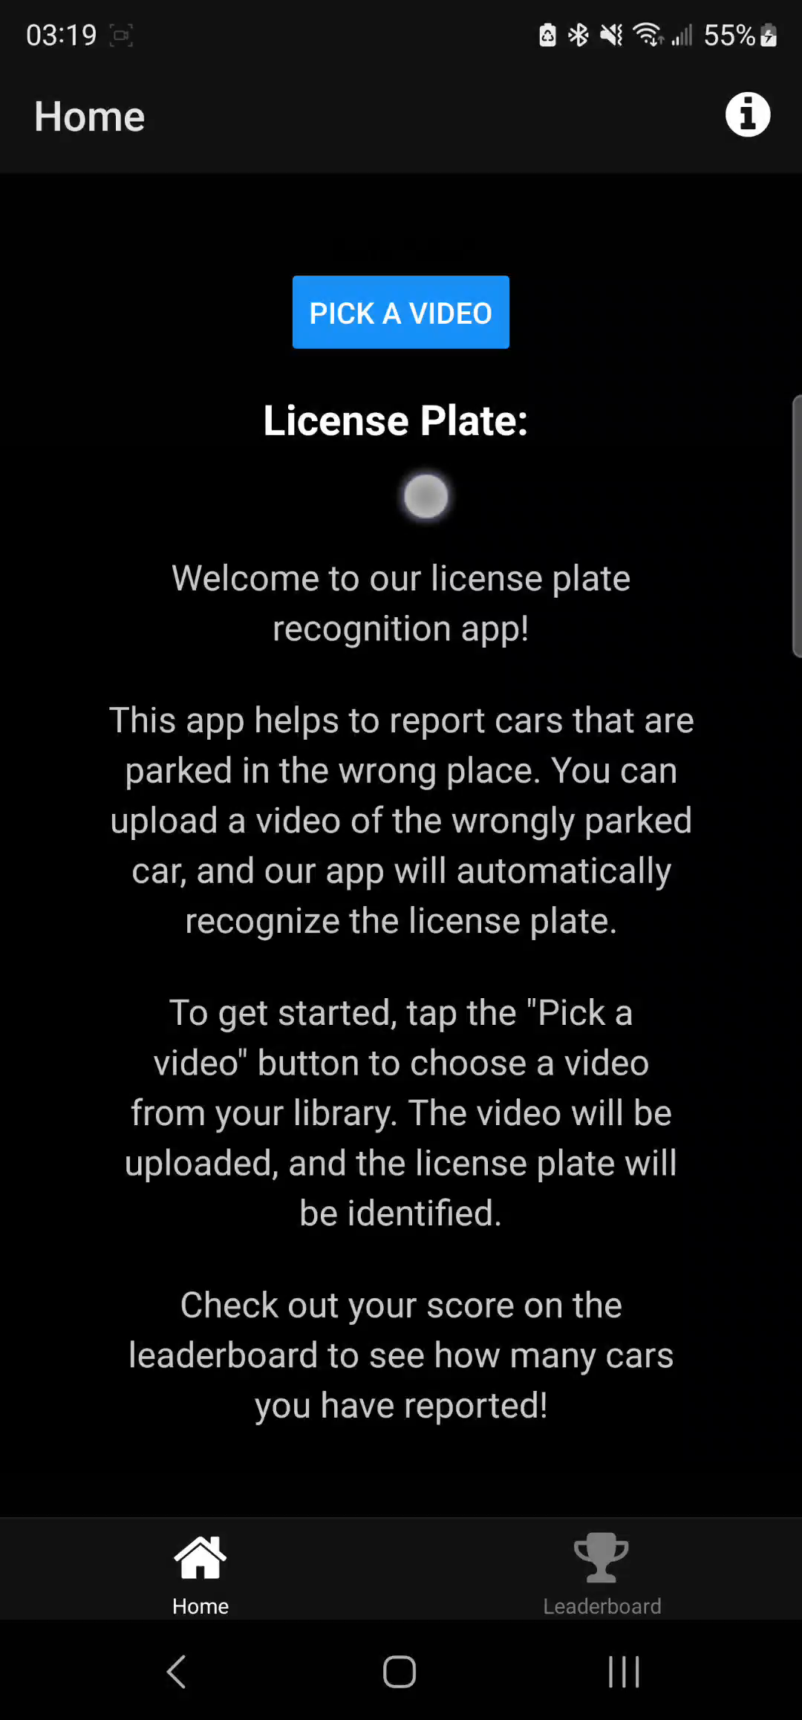
Real usage
So now let’s see a real possible usage with our application!

Slide 8
Thank you for listening!
Computer Vision Project III
710882199 - Enzo Haegel
410985099 - Savelii Spitsin

